Slide 1
Market Basket Analysis Using Apriori Algorithm
By
Divyabharathi S.

Slide 2
Business Problem
Retailers aim to understand customer purchasing behavior to optimize product placement, promotions, and cross-selling strategies.

Slide 3
Current Solution & Challenges
Traditional promotions are generic and may not drive sales effectively.
Manual product bundling is inefficient and lacks data-backed insights.
Need for data-driven product recommendations based on actual shopping patterns.

Slide 4
Proposed Solution
Using association rule mining (Apriori Algorithm) to uncover relationships between frequently bought items.
Identifies strong associations between products.
Helps create combo deals and optimized store layouts.
Provides insights for cross-selling strategies.

Slide 5
Benefits
Personalized product recommendations.
Increased sales through strategic bundling.
Improved customer experience with relevant promotions.

Slide 6
Evaluation
Support – Frequency of itemsets in transactions.
Confidence – Probability of item Y being purchased given item X is bought.
Lift – Strength of association; >1 indicates a strong positive correlation.

Slide 7
Dataset & Exploratory Data Analysis (EDA)
Dataset:
Groceries Dataset (transactions from a supermarket).
Contains products purchased together in each transaction.
EDA Findings:
Some items are frequently bought together (e.g., bread & butter, milk & cereal).
Certain items appear in high-value transactions.
Seasonal variations in purchasing behavior.

Slide 8
Algorithm Used: Apriori Algorithm
Step 1: Identify frequent itemsets based on support threshold.
Step 2: Generate association rules using confidence & lift.
Step 3: Filter strong rules for business insights

Slide 9
Best Rules & Insights
Top Association Rules Found:
Milk → Buns
(Strong correlation, suggesting bundling opportunity).
Milk → Beer
(Unexpected pattern, great for targeted promotions).
Yogurt → Fruits
(Health-conscious customers).

Slide 10
Business Recommendations
Strategic Product Placement: Place associated products closer together.
Cross-Selling Promotions: Discounted combos based on high-confidence rules.
Loyalty Programs: Personalized offers based on past purchases.
Online Store Recommendations: Customers who bought this also bought similar products

Slide 11
Visualizations
Heatmap of Lift Values (to show strong associations). Network Graph (to visualize product connections).

Slide 12
antecedents | consequents | support | confidence | lift
(yogurt, other vegetables, bottled water) | (whole milk) | 0.022063 | 0.682540 | 1.489664
(shopping bags, bottled beer) | (whole milk) | 0.020010 | 0.661017 | 1.442690
(rolls/buns, yogurt, other vegetables) | (whole milk) | 0.034377 | 0.656863 | 1.433623
(shopping bags, canned beer) | (whole milk) | 0.022063 | 0.656489 | 1.432806
(yogurt, soda, other vegetables) | (whole milk) | 0.027963 | 0.648810 | 1.416047
(yogurt, tropical fruit, other vegetables) | (whole milk) | 0.021293 | 0.648438 | 1.415235
(rolls/buns, other vegetables, pastry) | (whole milk) | 0.020780 | 0.642857 | 1.403056
(rolls/buns, shopping bags, other vegetables) | (whole milk) | 0.021036 | 0.640625 | 1.398184
(yogurt, sausage, rolls/buns) | (whole milk) | 0.022832 | 0.640288 | 1.397448
(yogurt, curd) | (whole milk) | 0.025398 | 0.630573 | 1.376246
Display
Top Confidence Rule

Slide 13
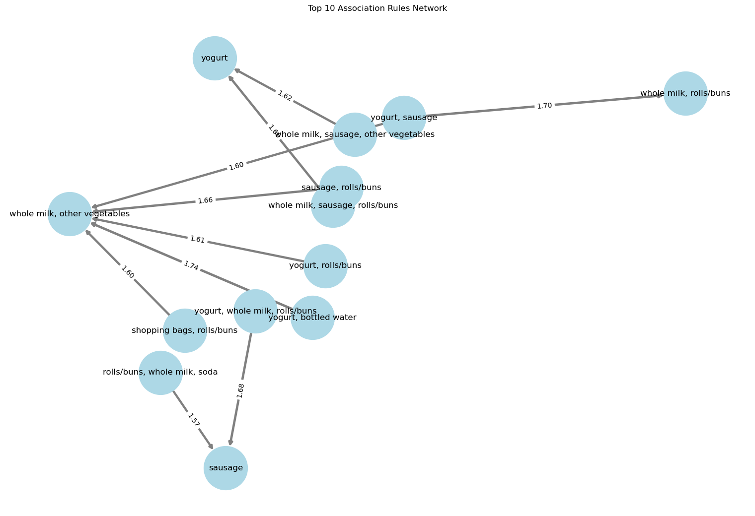

Slide 14
Conclusion
Market Basket Analysis helps businesses make data-driven decisions to improve sales, marketing, and customer satisfaction. By using association rules, retailers can create personalized experiences and drive revenue growth.

Slide 15
Thank you

